Slide 1
Java InputStream class
Java programs use byte streams to perform input and output of 8-bit bytes.
All input byte stream classes are descended from InputStream.
InputStream class is an abstract class. It is the superclass of all classes representing an input stream of bytes.
InputStream
AudioInputStream
ByteArrayInputStream
FileInputStream
FilterInputStream
ObjectInputStream
PipedInputStream
SequenceInputStream
StringBufferInputStream

Slide 2
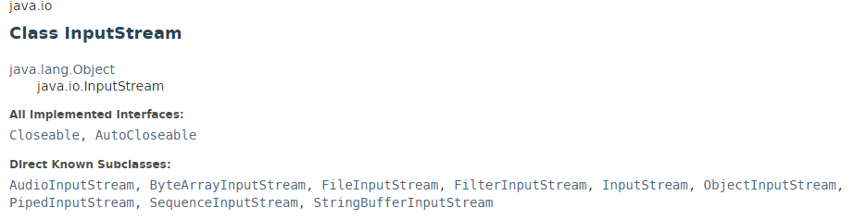

Java InputStream class

Slide 3
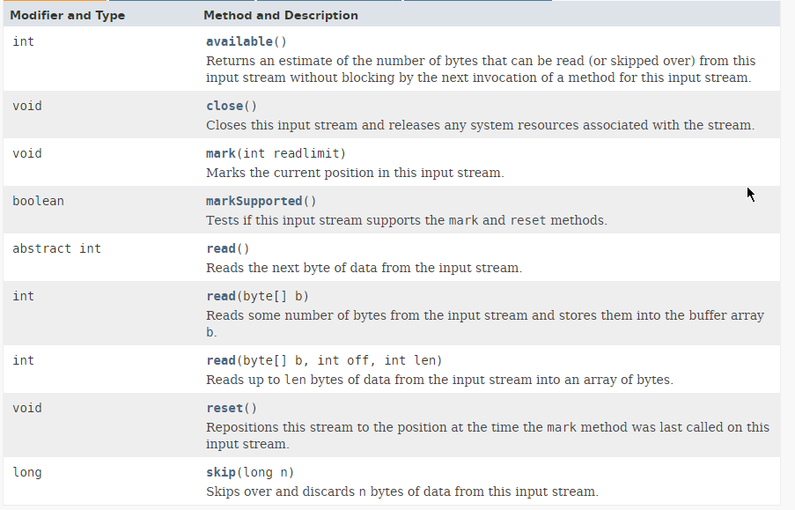
Java InputStream class

Slide 4
Java InputStream class
https://docs.oracle.com/javase/8/docs/api/index.html?java/io/InputStream.html

